Slide 1
Chapel Hill Museum a Brief History and Path Forward
Alan Rimer 1-25-17

Slide 2
Museum “History”
Founded in 1996 by members of the Chapel Hill Bicentennial Committee including Ida Friday, the Museum prospered and grew until its closing in July 2010
Attendance at the museum grew steadily to well over 20,000 visitors a year and provided education programs to over 3,500-4,000 students per year
Initially, the museum was run by an entirely voluntary staff. In 1999 an Executive Director was hired and the museum growth began to flourish
The Board of Directors and a whole cast of volunteers enhanced the efforts led by the Executive Director to make the museum a destination

Slide 3
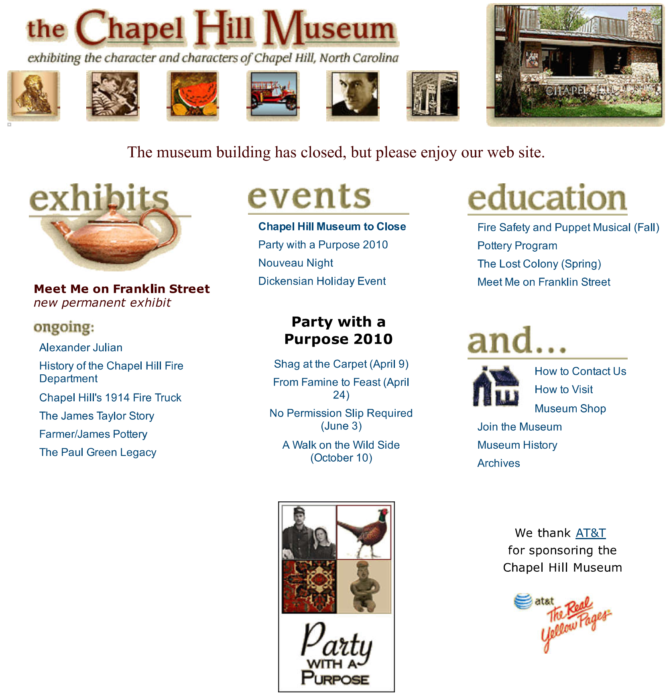

Slide 4
Mission
The mission of the Chapel Hill Museum was to "preserve, exhibit and interpret the history and culture of our town, our state and the region. The Museum serves as a community resource through exhibitions, educational programs, seminars and special events.”
Dillon Ripley’s comments were (are) entirely consistent with the evolution of the Chapel Hill Museum. Museums are the best laboratory for studying the problem of “how to create interest.” As Council Member Sally Greene noted in her email, the goal of a museum, in Ripley’s view, should be to make people interested in their surroundings.

Slide 5
How the Museum Worked in Collaboration With Others
Since its inception, the museum engaged in partnerships with numerous community organizations (over 40), UNC departments (14), and a host of individuals to further the mission of the museum
There were close ties with the Chapel Hill Historical Society which sought to cooperate on mutual grants
Strong working relationships were developed with a number of town departments including Fire, Police, and Parks and Recreation

Slide 6
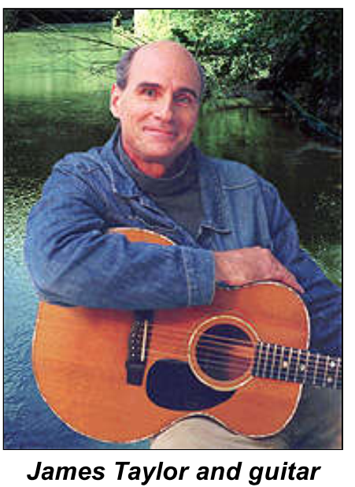
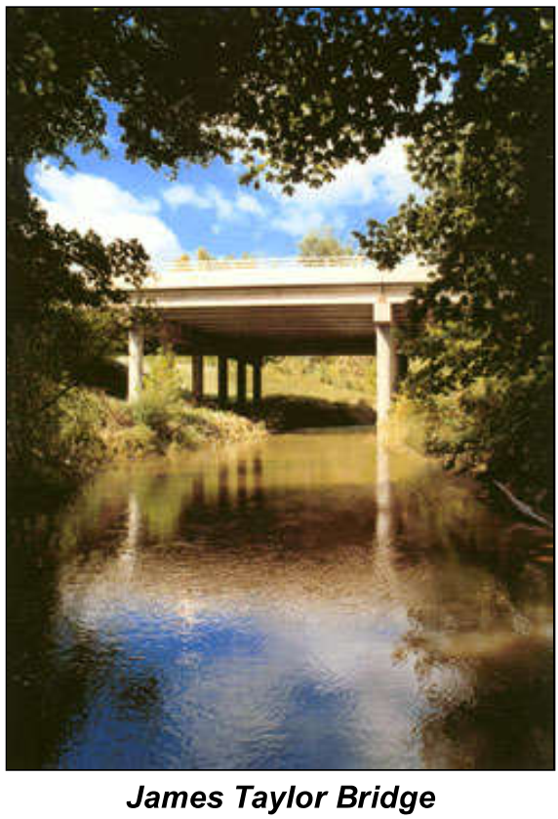
Museum Programs
As the museum grew, it developed a number of programs and permanent exhibits. These ranged from Chapel Hill's 1914 fire truck to "Carolina on My Mind: the James Taylor story" and the Paul Green Legacy
The Museum developed over 30 exhibits in a period of about seven years
Education was important and the Museum won a Governor’s Award for their outreach programs

Slide 7
The Museum’s Demise
The Museum had achieved a great deal and become a part of the Community
While the old Chapel Hill Public Library was a good home for the Museum, the building was in disrepair with problems with mechanical systems as well as the building itself
The Town could not afford to make the necessary improvements to the building infrastructure
The Museum was unable to fund the necessary improvements to the Town owned property and simultaneously maintain the Museum programs it had developed

Slide 8
Community Commitment
The Museum enjoyed wide community acceptance and participation. Over the years many board members put in countless hours as a real working board to make the Museum as successful as it became
Over the past several years, and with the guiding hand of Rev. Robert Seymour, the idea of a museum combined with the Visitors Bureau was born
Since that time contact has been made with nine of the many old Board Members, all of whom agreed that this was a wonderful idea and offered any help they could personally provide

Slide 9
No Decision is Irrevocable
As Winston Churchill said in 1942 regarding the 2nd World War: “Now this is not the end. It is not even the beginning of the end. But it is, perhaps, the end of the beginning.”
As we begin to look at the opportunities presented to us through the possible combination of the Visitors Bureau and a revived Museum we have much to draw upon
The reading material provided to us for this meeting offers some provocative and thoughtful views of how a museum fits into the cultural fabric of the community
From the historical perspective provided in the Ripley writings to the article by Parman on a museum's role in a community, the challenges and opportunities are broad

Slide 10
The Community Role of a Revived Chapel Hill Museum
From Parman's work the role can be:
A Visitors Attraction
A Memory Bank and Storyteller
An Attic and Treasure Trove
A Catalyst for Change
Many of these attributes also can be used to describe activities of the Visitors Bureau
The challenge will be to find the appropriate means to engage the Town Council, the Orange County Commissioners, and citizens to come together to fashion such a combination of the Visitors Bureau and Museum

