Slide 1
The Future of Chapel Hill’s Past

Slide 2
How do people “use” history? How can history be meaningful? Sustainability of historic institution?

Slide 3
What’s in a name?
History Museum
Cultural Center
History Center
How are they different than a ….
Visitor’s Center

Slide 4
What does the Town of Chapel Hill say about history?

Slide 5
How do people use history?

Slide 7
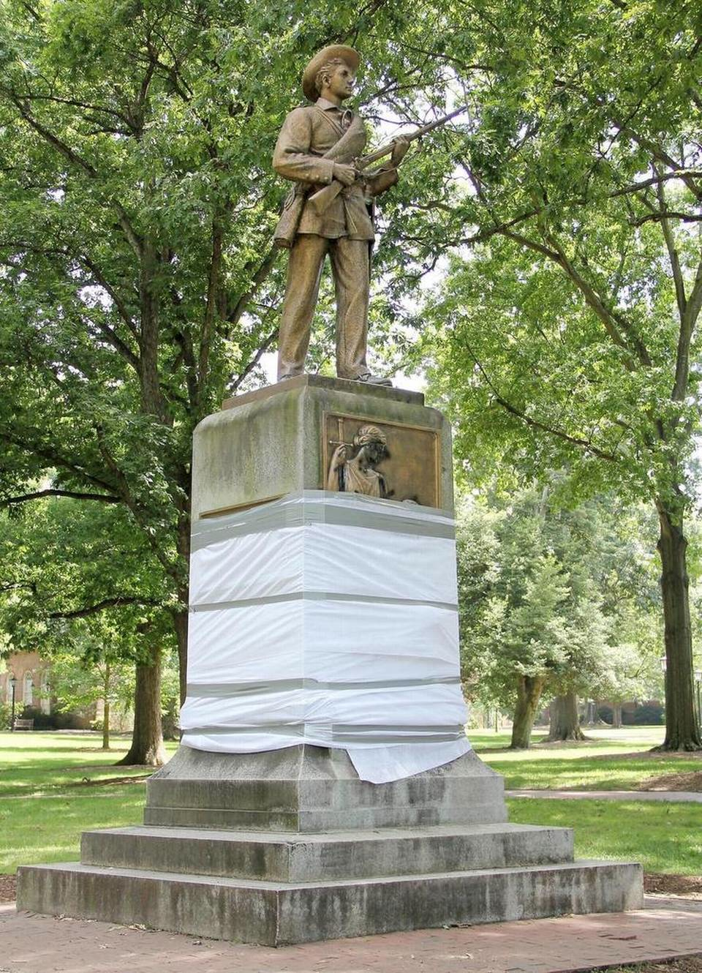
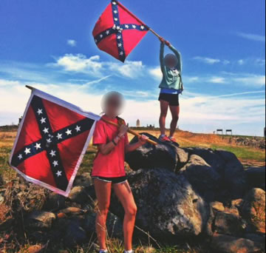
Chapel Hill’s Conflicts with the Past
Historic Chapel Hill neighborhoods fight to curb development

Slide 8
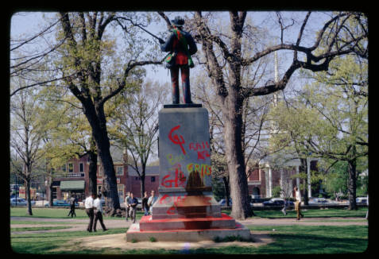
The museum is a place and provides a platform to confront the past.
Museums matter only to the extent that they are perceived to provide the communities they serve something of value beyond their own mere existence.

Slide 9
Dual Role of a Chapel Hill Museum
Permanent exhibit gallery – to serve needs for tourists want orientation, background, and information on Chapel Hill
Rotating exhibit gallery – Space for community conversations and public created displays

Slide 10
The Museum As Attraction
How the National Park Service sees it…

Slide 11
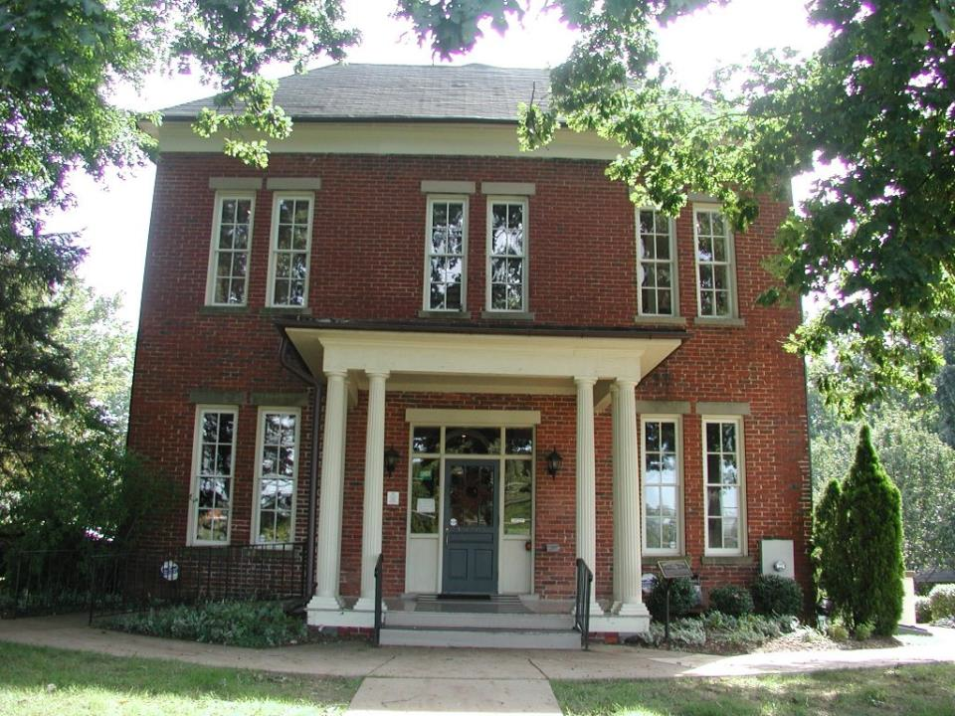
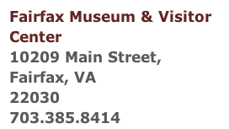

Slide 12
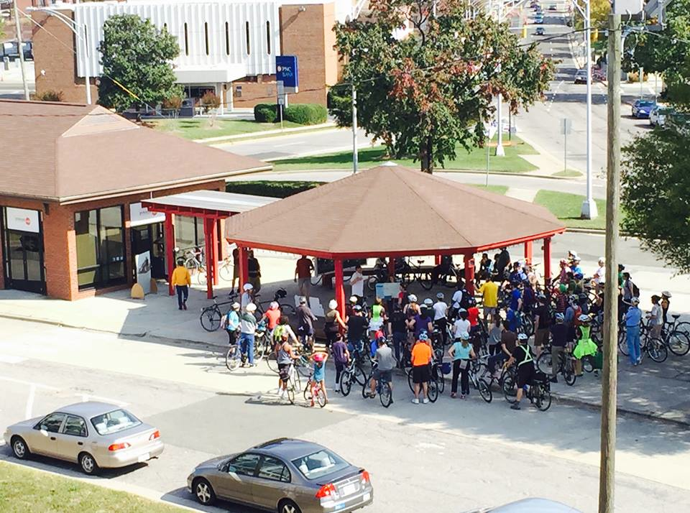
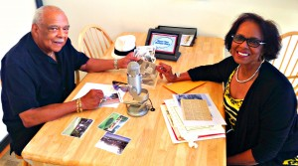
Museum of Durham History
Hosting community exhibits
Public programming
Museum without walls
Oral histories
Kids dress up

Slide 13
Benefits to Location

Slide 14
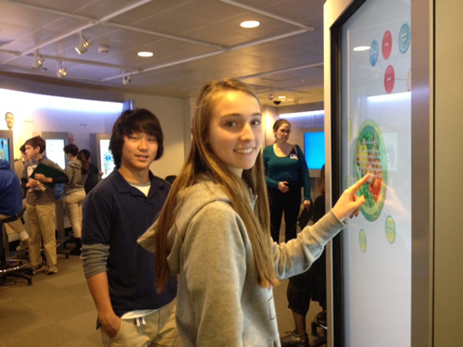
Can it be a tool for the town?
Outreach for Planning Department
Inform on development and services
Educational opportunities Parks and Rec
Summer Camps
Classes and workshops
Summer Youth
Employment Program

Slide 15
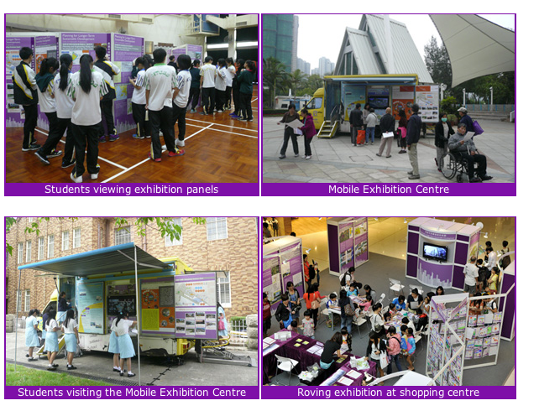

Slide 17
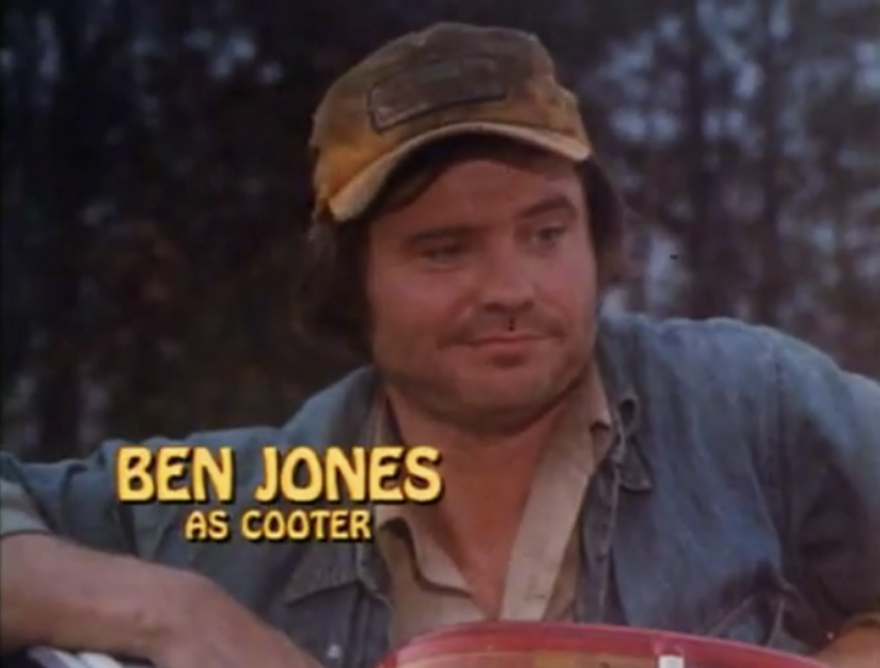
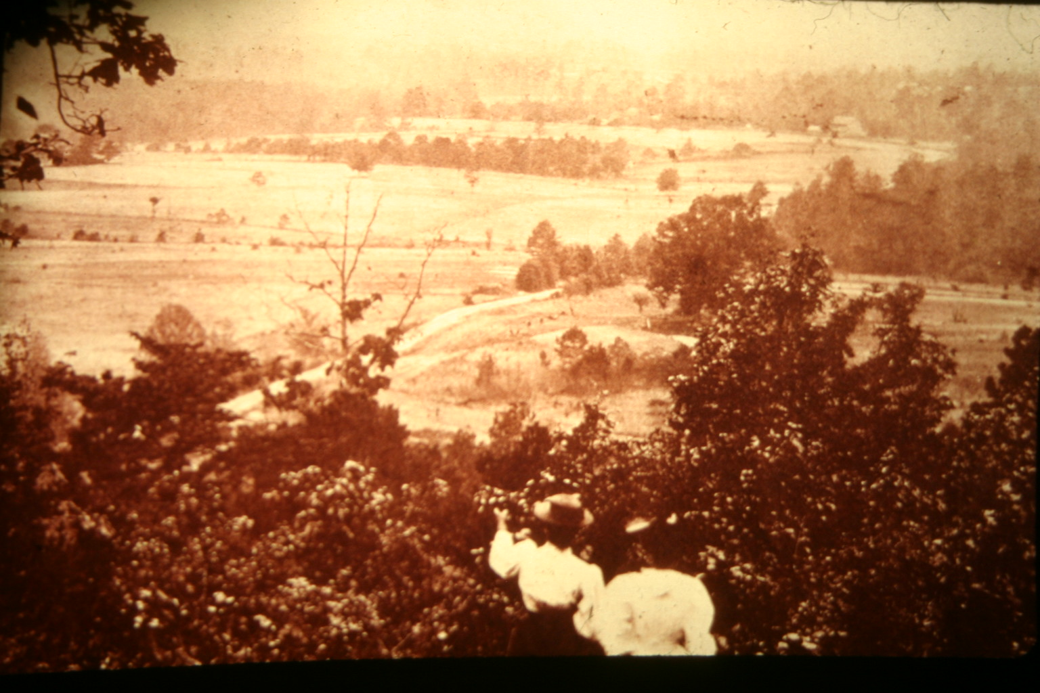
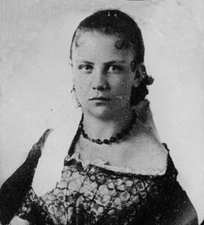
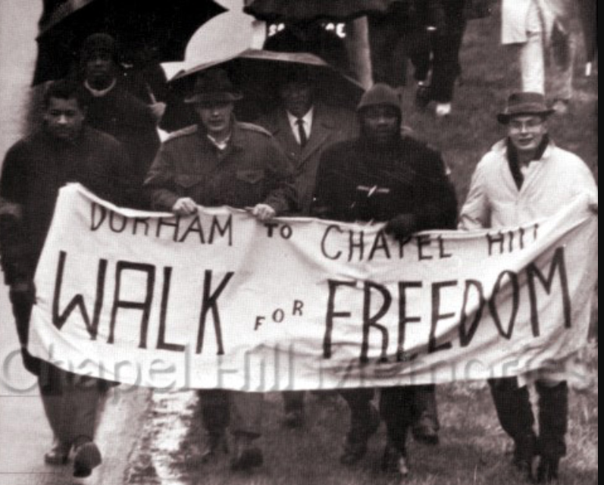
Chapel Hill Stories Main gallery exhibit
Highlight 50 stories of that define Chapel Hill
Places, people and things
Humanizes the past for the present
Makes human connection with history

Slide 18
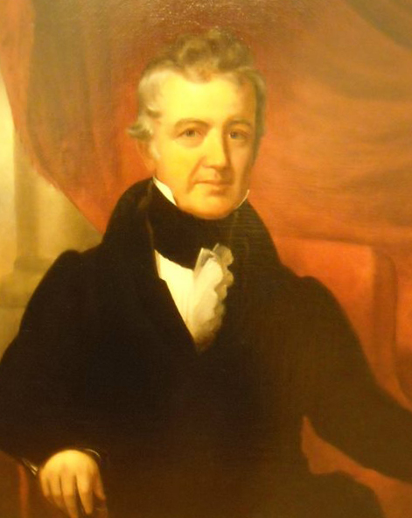
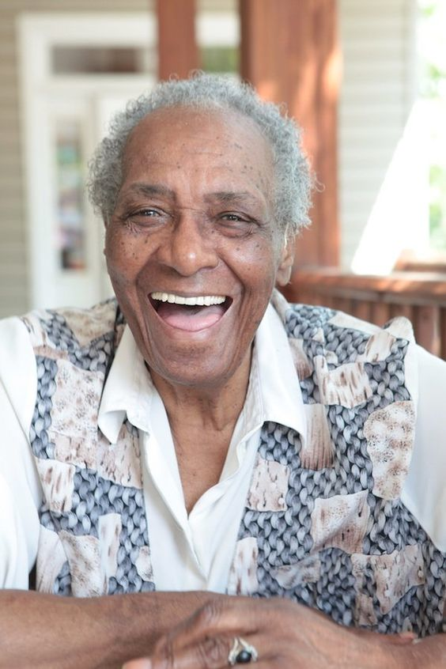
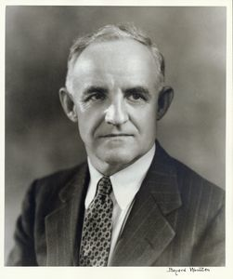
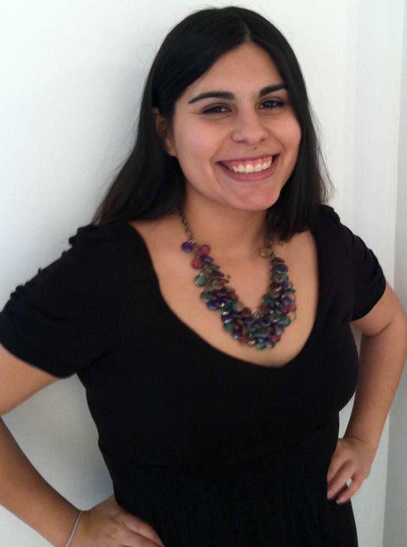
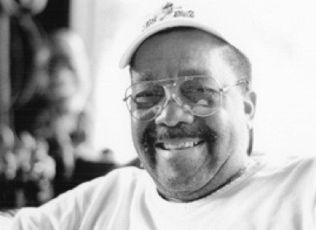
Museum would remind Chapel Hill of their long history of striving for betterment. Increase tourism through centrally located attraction. Provide public interface for Town departments

Slide 19
Presentation created by Ernest Dollar Director City of Raleigh Museum

