Slide 1
Town of Chapel Hill
Development Review and Approval Process
Notes:
Hello, and thank you for watching this brief presentation on the Town of Chapel Hill development review process. This short, 6 slide presentation will walk you through our development review flow chart.

Slide 2
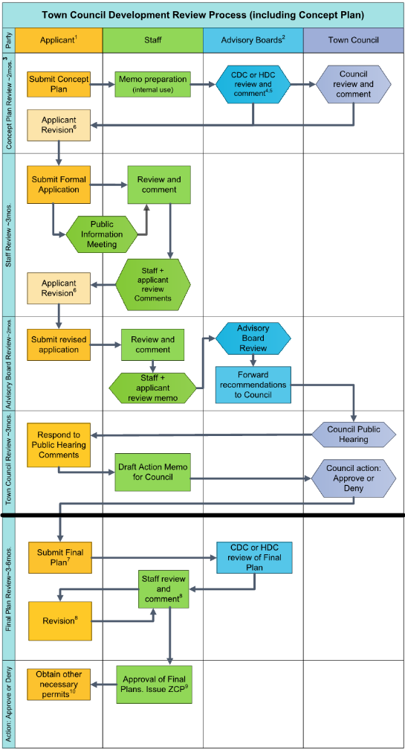
Development Review Process
All new development projects must apply for permit(s)
Most large projects require Town Council approval
Process typically takes 12-18 months
Notes:
It is important to know that all development projects occurring within the Town of Chapel Hill limits require one or more permits before they can begin construction. Often, large development projects require approval by the Town Council. These projects may include rezonings or may be asking for special standards not allowed by the zoning district. They may also exceed certain size thresholds that would require Town Council approval. When Council approval is involved, the process typically take 12-18 months, though that time may vary depending on the complexity of the project.

Slide 3
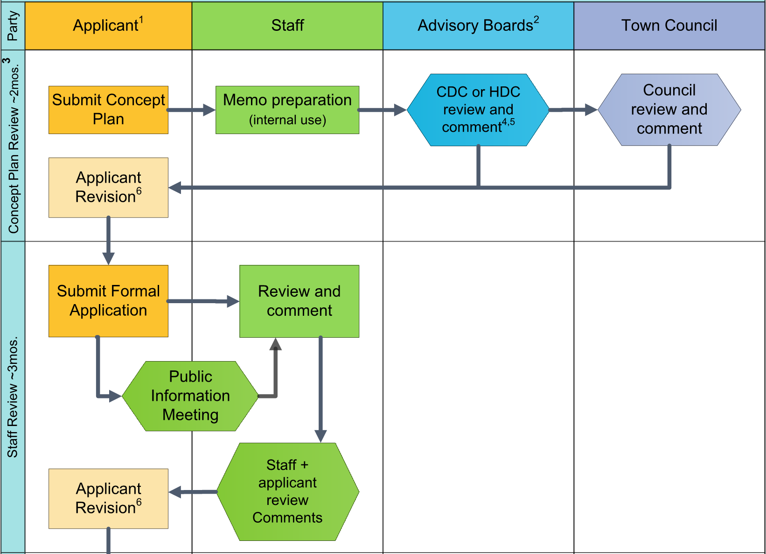
Part 1: Concept Plan and Staff Review
Notes:
The first step involves the applicant submitting a Concept Plan application. A concept plan is supposed to be a rough sketch, outlining what the applicant is envisioning, so that they can get feedback from the Community Design Commission and Town Council. This process takes approximately 2 months, and results in a set of comments for the applicant to use if they decide to move forward with a formal application. It is important to note that Concept Plans are preliminary, and do NOT result in an approval of any sort.
If the applicant moves forward with a formal application for development, the next step begins. During this step, Town Staff will review the application, hold a public information meeting, and make comments. The applicant will then revise their application based on these comments and resubmit. This process can involve several rounds of review, and typically lasts 3 months.

Slide 4
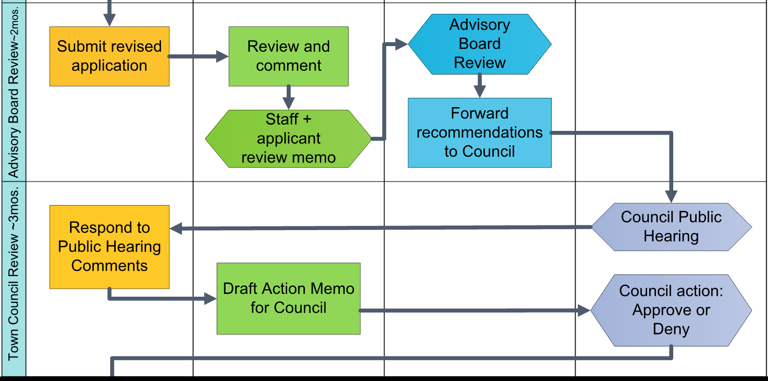
Part 2: Advisory Board and Town Council Review
Notes:
After the application has been deemed satisfactory, it will be forwarded to the Advisory Boards for review. The Advisory Board meetings are typically scheduled during a 2 month timeframe, during which each Board will review and draft recommendations that are forwarded to Town Council.
The Town Council review that follows usually takes 2-3 months, and is split between 2 meetings. The Town Council will open a Public Hearing at the first meeting where they will receive Advisory Board Recommendations and hear public comment. A second meeting is held (typically during the following month), where the Council will hear any new feedback from the public and make a decision.

Slide 5
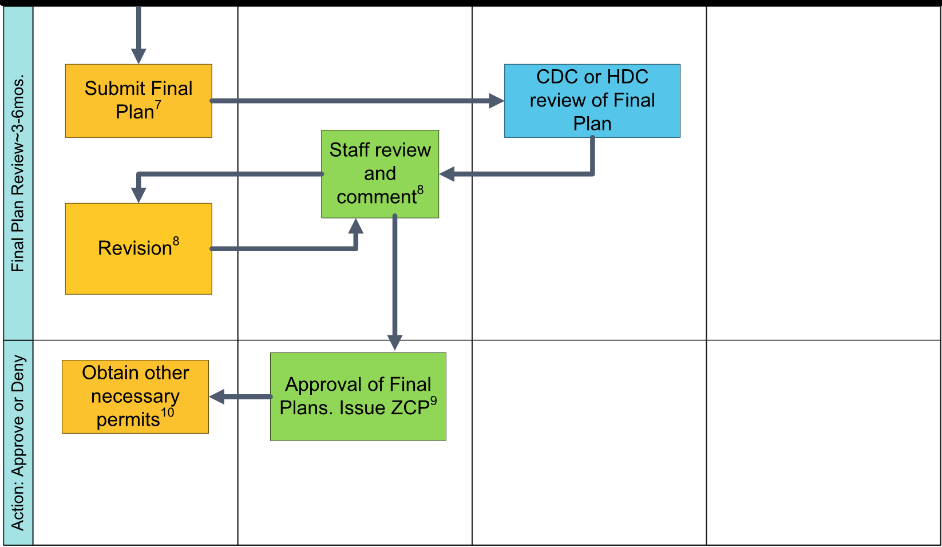
Part 3: Final Plans and Permitting
Notes:
If the Town Council has approved the project, it can proceed to the Final Plans stage. This is where the Applicant submits detailed engineered drawings that Town Staff reviews closely. This stage can last anywhere from 3-6 months, and involves departments from all across the Town. There may be additional Advisory Board review during this time, if the Town Council required it as part of the approval. Once the application is finally deemed to be compliant with Town Code and ready for construction, a Zoning Compliance Permit will be issued.

Slide 6
Questions
For more information, contact:
Email: planning@townofchapelhill.org
Phone: 919-968-2728
Or Visit:
https://www.townofchapelhill.org/government/departments-services/planning/large-development-projects
Notes:
If you have any questions, please contact us at the email or phone number listed here, or visit the Town’s website. Thank you again for viewing this presentation, and we hope you found it helpful.

