Slide 1
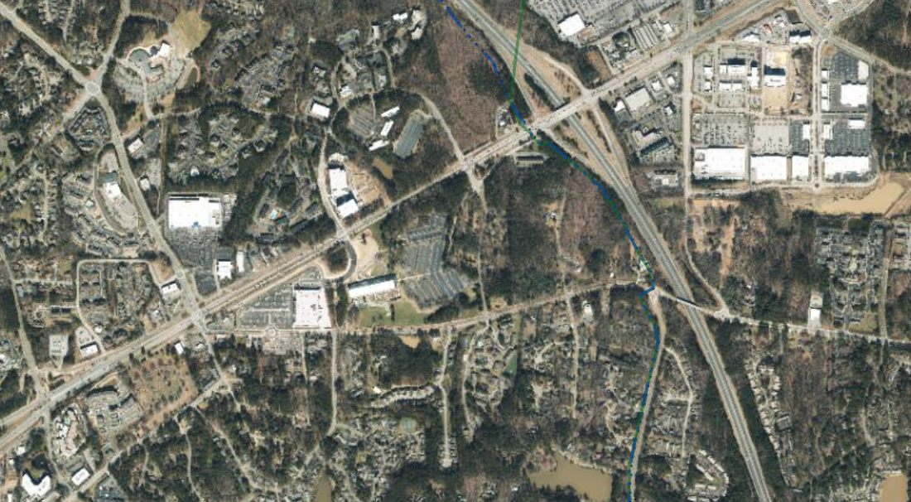
Market potential for the area adjacent to The Parkline
DRAFT PRESENTATION
Council Committee on Economic Sustainability
October 6, 2023

Slide 2
Outline of presentation
Overview of local and regional retail market
Market demands in comparison to adjacent retail areas
Site Plan as developed by Town Staff
Potential market use types for the Parkline site
Recommendations

Slide 3
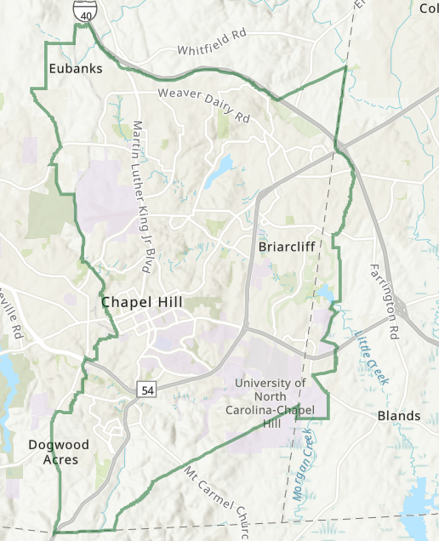
Retail Hubs in
Chapel Hill
Larger retail areas
Smaller retail areas
_________________
Chapel Hill has approximately 2.6 million square feet of retail space.

Slide 4
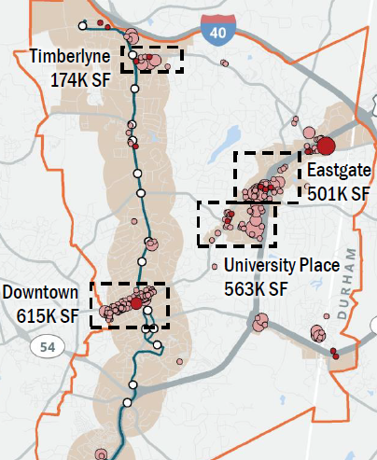
Square feet in retail hubs in Chapel Hill.

Slide 5
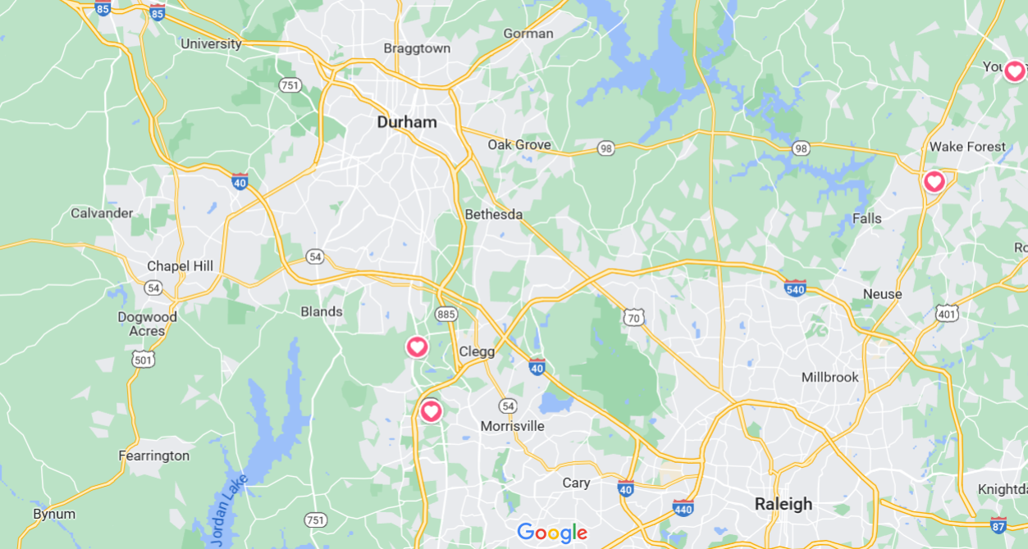
We lose a portion of our retail base to the Triangle Region.

Slide 6
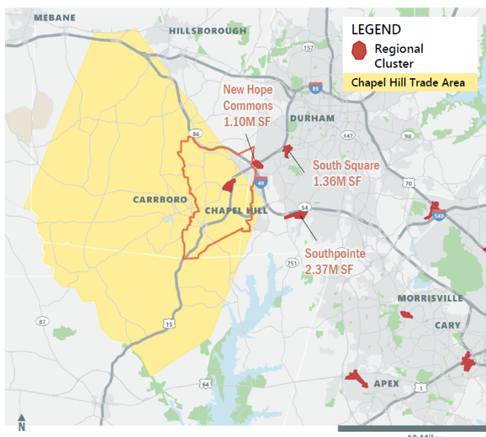
Roughly 4.7 million square feet of retail within a few miles of our border.

Slide 8
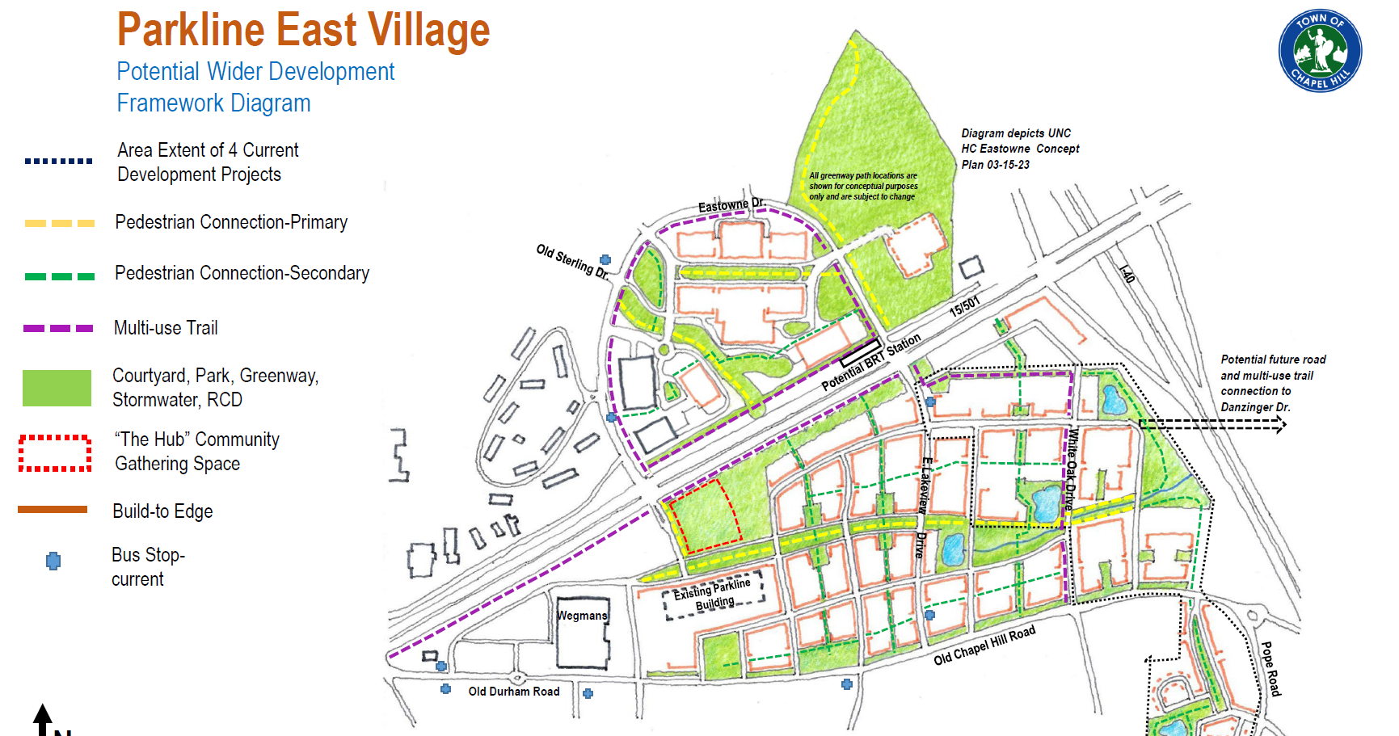

Slide 9
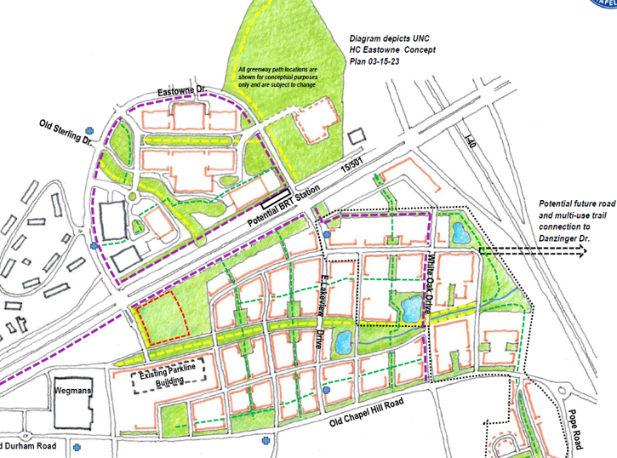
Commercial potential of the Parkline site
Neighborhood retail facing onto the community green.
This retail could support with basic neighborhood type needs and also benefit from the traffic headed to Wegmans
Live-work type units facing the primary boulevard.
These could be for one-man offices for engineers, architects, and other professional services types that have a relatively low traffic impact.

Slide 10
Types of Commercial Establishments
1. Neighborhood Retail. There are two kinds of this possible:
Strip retail: This could include 10-20,000 s.f. of side tenants for Wegmans, including businesses like Starbucks, a grab-and-go casual restaurant like Panera, a UPS store, pizza delivery, a shoe store, nail or hair salons, a phone store, and physical therapy or dental offices.
Specialty retail: This could include 6-10,000 square feet wrapping around a community green. Potential tenants include a local coffee shop, pub, bakery, deli/convenience store, frozen yogurt store, and bike store.
Small Inn or Hotel. This could be a limited-service, two- or three-star property with 25 to 50 rooms located over or behind the retail in the community hub.
Live Work Space. There are two kinds of this:
Higher exposure and accessibility: There might be demand for 50 units along the parkway in locations where visitors could park on the street. Potential tenants include engineers, accountants, therapists, travel specialists, designers, and other professionals who occasionally meet with their customers face-to-face.
Lower exposure and accessibility: This could include another 50 units off the main parkway. These tenants would be the same kind of professionals but with fewer employees or visitors. Because this space does not need the same visibility, it should be located on the side streets of the parkway (and not buried within the residential area to the east), within a five- or ten-minute walk of the retail center.

Slide 11
I. Create a hierarchy of streets that establishes a "front door" for the project and a sense of arrival. II. Focus commercial development on the grassy knoll, where it can build off the strength of both Wegmans and the Eastowne campus. III. Add more streets in the residential area to reduce block size and the institutional character of apartment development there. This will encourage more for-sale housing in the rest of the area, make live/work more viable, and draw more town-wide residents to the local retail.
Other recommendations:

Slide 12
Additional recommendation:
Connect the two sides across Lakeview Drive of this potential district.

Slide 14
Market potential for the area adjacent to The Parkline
Questions?
Council Committee on Economic Sustainability
October 6, 2023

