Slide 1
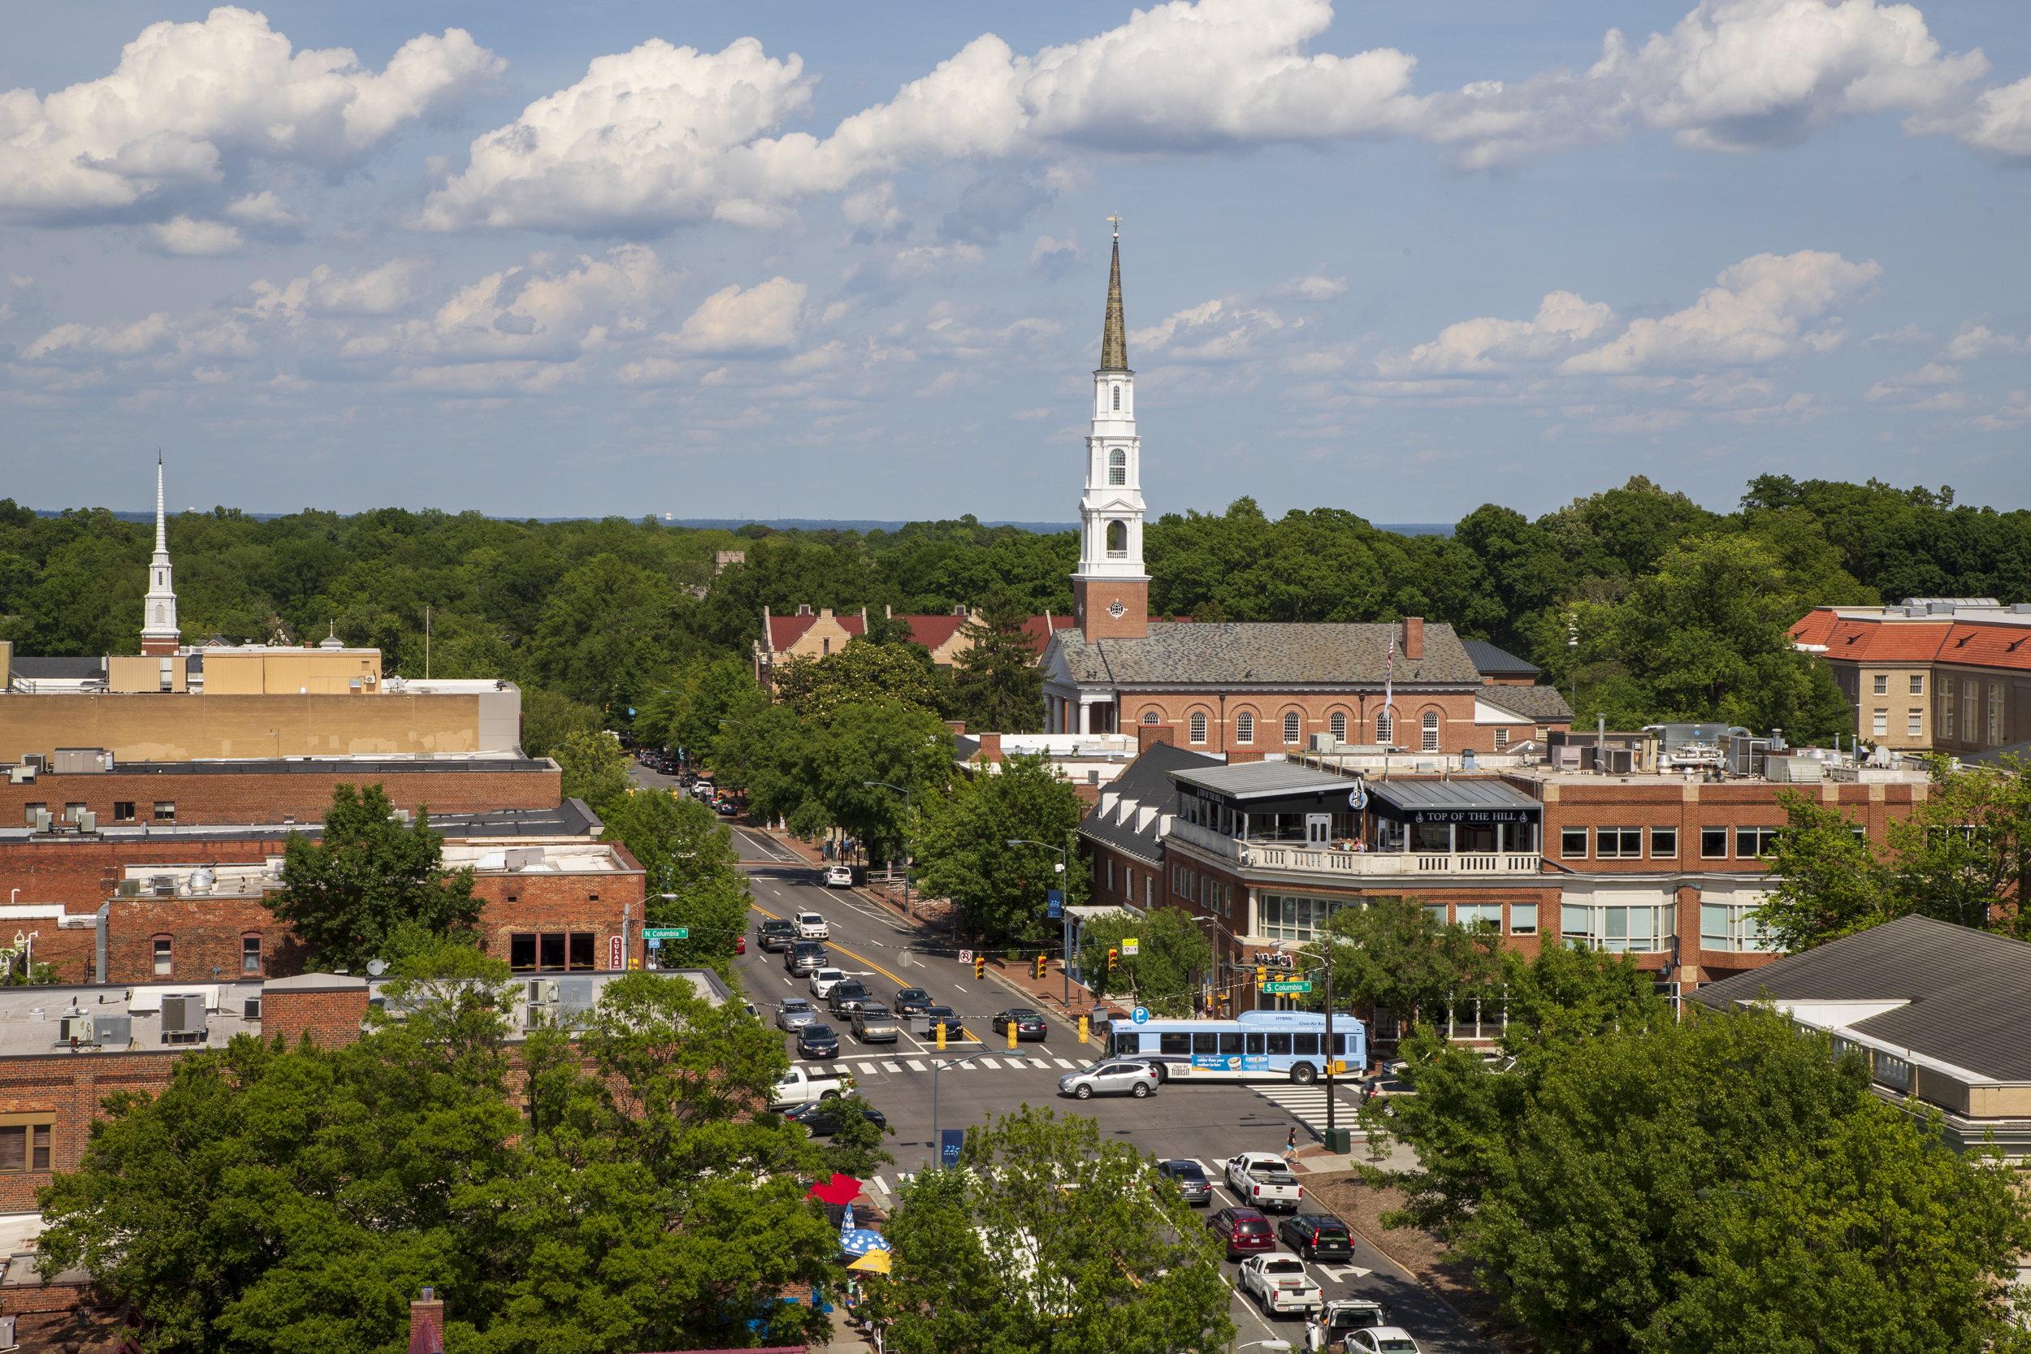
Governance Services Servicios de gobierno
Notes:
Welcome! We are Matt DeBellis and Brenton Hodge from the Governance Services Department.

Slide 2
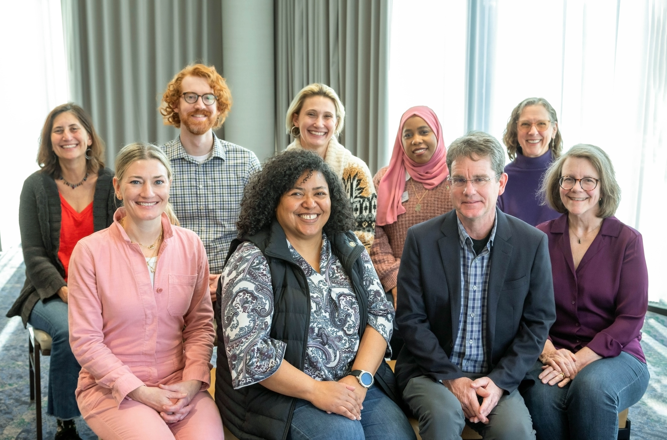
Council Concejo municipal
2023-25 Town Council
2023-2025 Concejo municipal
Notes:
A few weeks ago the Town Manager spoke about the Council and how government works.
The Governance Services Department:
works on creating an agenda for meetings,
helping staff prepare items being reviewed by council,
making sure all public notice laws are followed,
helping to create ordinances and resolutions passed by the town Council
In general, we help guide the council on protocol, rules, and regulations.

Slide 3
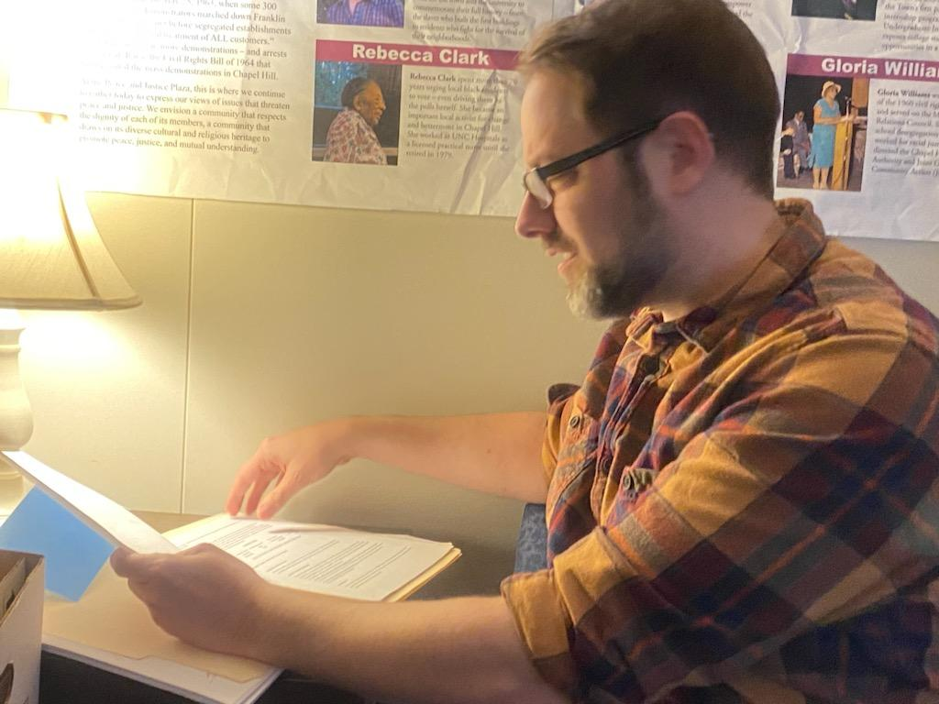
Records Expedientes
Notes:
The town clerk is also the custodian of all records created by the town of chapel hill
We help guide town employees on the preservation, archiving or destruction of town records
We also respond to public records requests for town information.

Slide 4
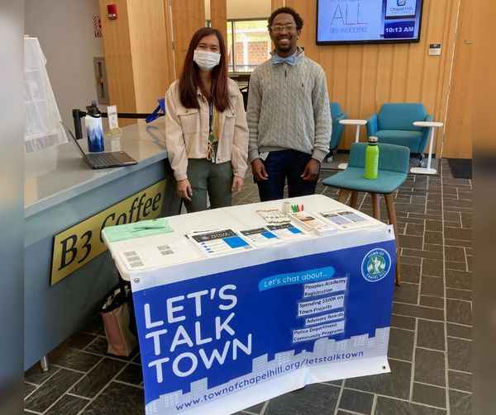
Boards and Commissions Comités y comisiones
Notes:
Our team is also responsible for
recruitment of volunteers who serve on 16 boards and commissions (number subject to change!)
These boards advise and provide review and recommendations to our Town Council
engage the public with programs like Let’s Talk Town and People’s Academy

Slide 5
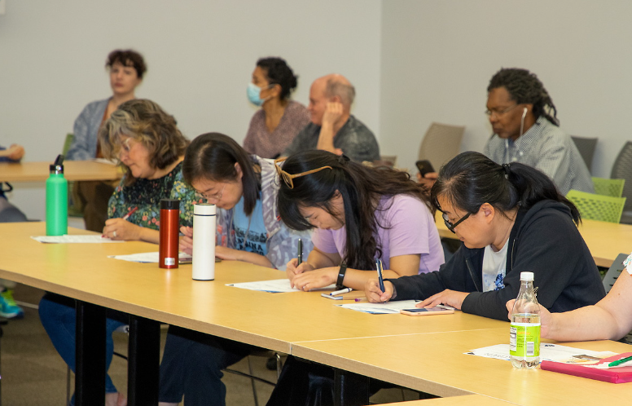
Quiz Time! ¡Veamos lo que sabe!
Notes:
Now we’re going to take a quiz!
This is an uncomplicated approach to Governance Services, so this should be easy for everyone, even if you don’t know any of the rules related to the Town Council.
A prize will be given out for the top score or scores.

Slide 6
The Governance Services department also does:
El departamento de Servicios de gobierno también se encarga de lo siguiente:
A. Domestic partnership registrations
B. Proof of life attestations
C. Notary public acts
D. All of the above
A. Registro de parejas de hecho
B. Certificación de prueba de vida
C. Actas notariales
D. Todo lo anterior
Notes:
D! All of the above! We do it all! Some of the documents we notarize are
Oath of Office
Some contracts
Automobile titles

Slide 7
Which Town records can the public request?
¿Qué expedientes municipales puede solicitar el público?
A. Only records about the requestor
B. Most records, except for confidential records
C. Only the snack budget
D. Only publicly available information
A. Solo expedientes sobre el solicitante mismo
B. La mayoría de los expedientes, excepto los confidenciales
C. Solo el presupuesto para aperitivos
D. Solo información pública
Notes:
Correct answer is B!
Anyone (even those who don’t live in Chapel Hill) can request public records. Every record the Town creates is public; however some information is considered “confidential”:
A “trade secret”
An account number for electronic payment

Slide 8
Why should you serve on a board?
¿Por qué formar parte de un comité?
A. Have input into what happens in your community
B. Learn more about local government
C. Free snacks!
D. A&B
A. Contribuir a lo que sucede en la comunidad
B. Saber más sobre el ayuntamiento
C. ¡Aperitivos gratis!
D. A y B
Notes:
D! The Boards we have (and what they do) are:
Board of Adjustment
Downtown Partnership
Cultural Arts
Public Library
Community Design
Community Policing
Cultural Arts Commission
Environmental Stewardship
EZ Rider
Grievance Hearing Board
Historic District
Housing Advisory Board
Human Services
OWASA
Recreation Parks and Greenways
Planning
Stormwater Management Utility
Transportation and Connectivity
Members on a Board or Commission:
Provide Council with information, recommendations and community perspectives that inform Council Decisions
Dive deeper into specific issues based on board’s charge
Offer additional opportunities to discuss public issues (some Boards)
Provide opportunities for community members to become more involved in decisions that affect them
Appointed by Town Council

Slide 9
What can you expect once appointed? Choose all that apply:
¿Qué ocurrirá una vez le nombren? Marcar todo lo aplicable:
Taking the oath of office
Advisory Board training
Code to the snack closet
Materials to study
Jurar el cargo
Capacitación para el comité consultivo
Código para el armario de aperitivos
Materiales de estudio
Notes:
C! What you can expect is:
taking an oath of office,
getting training for your particular board

Slide 10
What assistance does the Town offer Board members?
¿Qué ayuda ofrece el ayuntamiento a los miembros del comité?
Stipend towards childcare
Transportation assistance
Language Access
All of the Above
Estipendios para el cuidado de los niños
Asistencia con el transporte
Acceso de idioma
Todo lo anterior
Notes:
D! The town does not have any historic recipes ☹
assistance if needed weather it be child care
language access
transportation
technology

Slide 11
Where can you apply to be on a board?
Where can you apply to be on a board?
La sala del concejo municipal
La página web del ayuntamiento
La oficina del alcalde
La oficina de Correos de los EE. UU.
In the Council chamber
Town’s website
Mayor’s office
U.S. Post Office
Notes:
B! In addition….(QR code on next screen), take out your phones now!

Slide 12
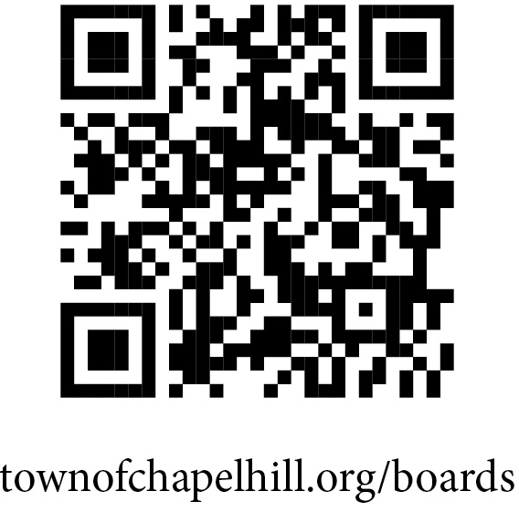
Apply now!
¡Envíe su solicitud!
Town of Chapel Hill Advisory Boards
Comités consultivos de la Ciudad de Chapel Hill
405 Martin Luther King Jr. Blvd.
Chapel Hill, NC 27514-5705
Phone: (919) 968-2844
Email: advisoryboards@townofchapelhill.org

