Slide 1



Town of Chapel Hill, NC
October 2024
Evergreen Solutions,
LLC
Classification and Pay Study

Slide 2


JAT CONTENT
The JAT collects information on the following:
Section 1
  Job Overview
  Type of Work Performed
  Education and Work Experience
Section 2
  Essential Job Functions
Section 3
  5 Job Factors: Leadership, Working Conditions, Complexity, Decision Making, and Relationships
Section 4
  Equipment and Machinery
Section 5
  Physical Abilities
04

Slide 3
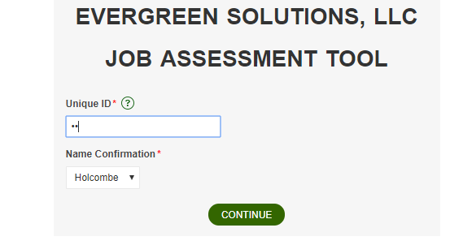
JAT GETTING STARTED
Step 1 - Login w/ Unique ID
04

Slide 4
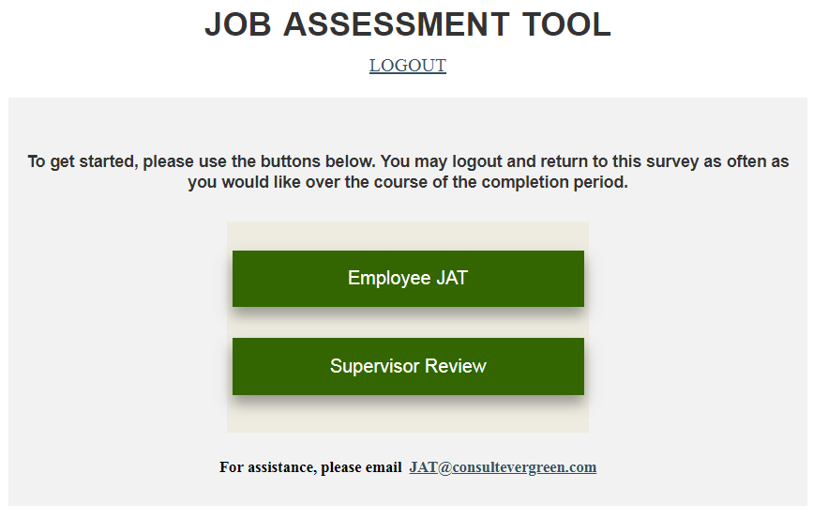
JAT GETTING STARTED
Step 2 - Login Menu
04

Slide 5
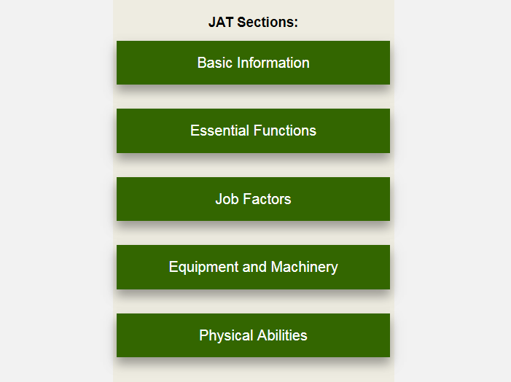
JAT GETTING STARTED
Step 3 - JAT Menu
04

Slide 6
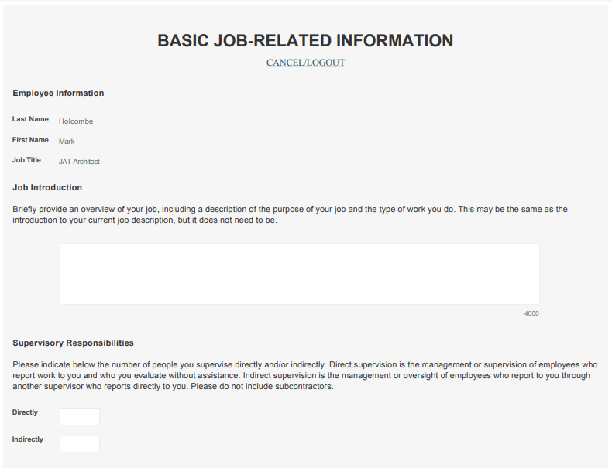
JAT
Section1 - Basic Job Information
04

Slide 7
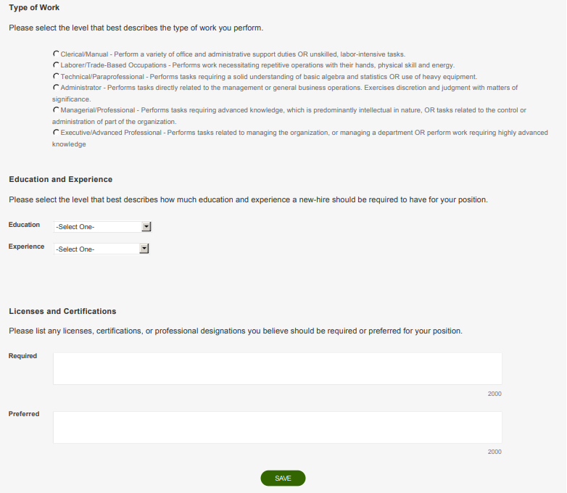
JAT
Section1 - Basic Job Information
04

Slide 8
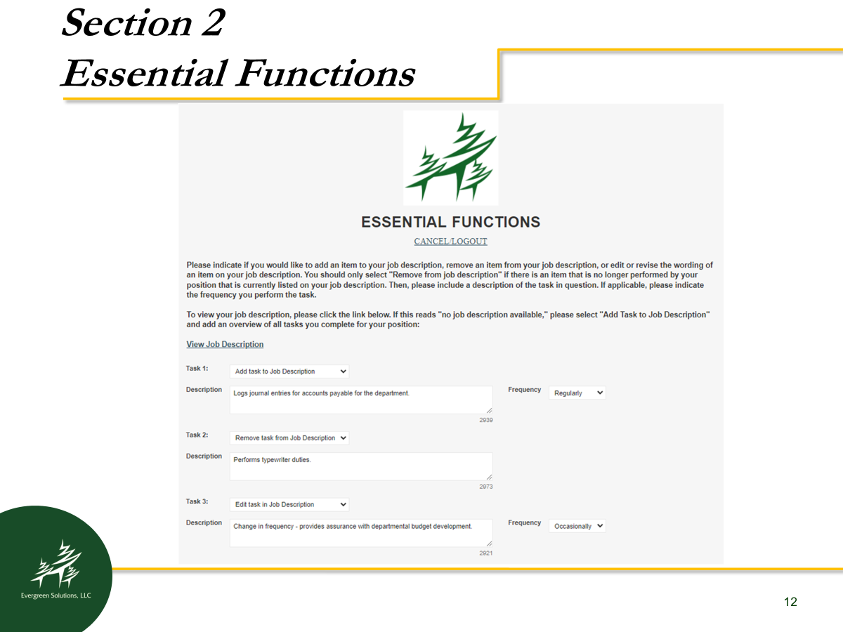
JAT
Section1 - Essential Functions
04

Slide 9
JAT
Section 3 - Compensatory Factors
04

Slide 10
JAT
Section 3 - Compensatory Factors
04
Please provide below a brief explanation of why the closest match you selected applies to your job. You may reference specific job functions, descriptions of projects/programs, and/or any details about your job that will help clarify and support your selection.

Slide 11
JAT
Section 3 - Compensatory Factors
04
Please provide below a brief explanation of why the closest match you selected applies to your job. You may reference specific job functions, descriptions of projects/programs, and/or any details about your job that will help clarify and support your selection.

Slide 12
JAT
Section 3 - Compensatory Factors
04
Please provide below a brief explanation of why the closest match you selected applies to your job. You may reference specific job functions, descriptions of projects/programs, and/or any details about your job that will help clarify and support your selection.

Slide 13
JAT
Section 3 - Compensatory Factors
04
Please provide below a brief explanation of why the closest match you selected applies to your job. You may reference specific job functions, descriptions of projects/programs, and/or any details about your job that will help clarify and support your selection.

Slide 14
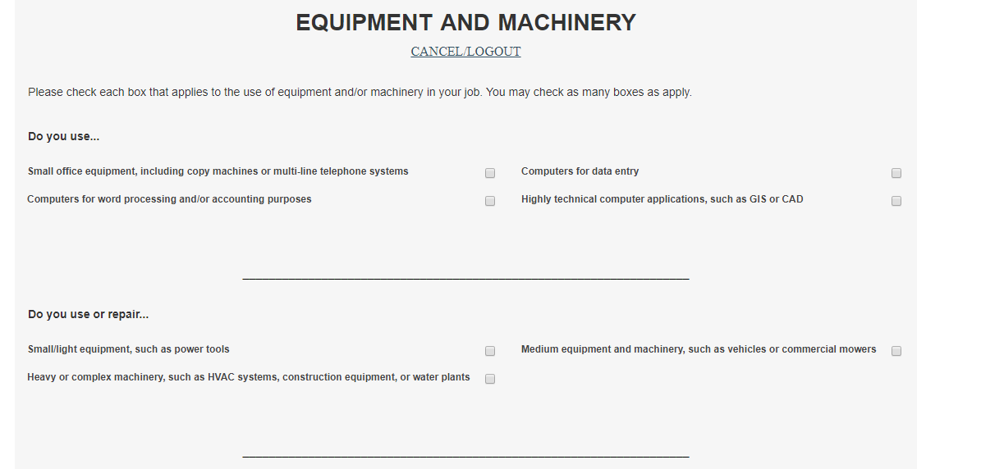
JAT
Section 4 - Equipment & Machinery
04
Please provide below a brief explanation of why the closest match you selected applies to your job. You may reference specific job functions, descriptions of projects/programs, and/or any details about your job that will help clarify and support your selection.

Slide 15
JAT
Section 5 - Physical Abilities
04
Please provide below a brief explanation of why the closest match you selected applies to your job. You may reference specific job functions, descriptions of projects/programs, and/or any details about your job that will help clarify and support your selection.

Slide 16
JAT - Tips
After each section click the “Save” button
JAT will timeout after one hour in a single section, click SAVE to avoid the timeout
Questions/concerns? Contact us!
  jat@consultevergreen.com - CH
  850-383-0111
04

Slide 17
JAT – Supervisor Review
Supervisors will review JAT responses:
A Supervisor CANNOT change answers, and this is not a performance evaluation.
A Supervisor can only agree or disagree and provide additional comments.
The Supervisor’s Review period begins after employee JAT entry is complete.
The person who will review your JAT is determined by your project leadership team.
04

Slide 18
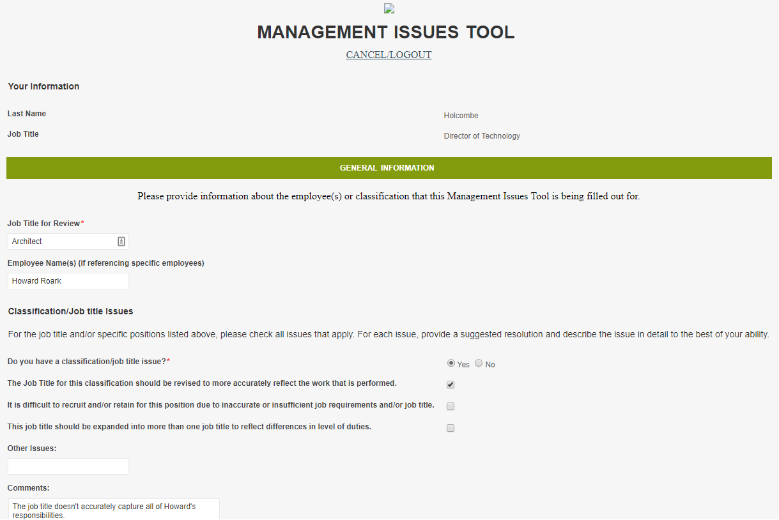
MIT - Management Issue Tool
04

Slide 19
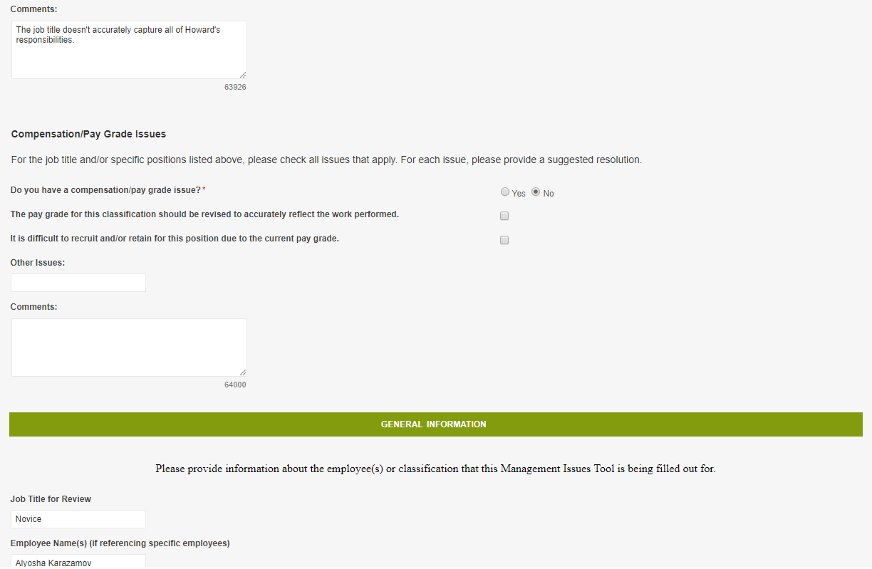
MIT - Management Issue Tool
04

Slide 20





Thank You!
Rob Williamson, Project Manager
Evergreen Solutions, LLC
850-383-0111
rob@consultevergreen.com
2528 Barrington Circle, Unit 201
Tallahassee, Florida 32308
850-383-1511
www.ConsultEvergreen.com

