Slide 1
Carolina North
Carolina North Annual Report for 2009-10
Chapel Hill Town Hall
September 29, 2010

Slide 2
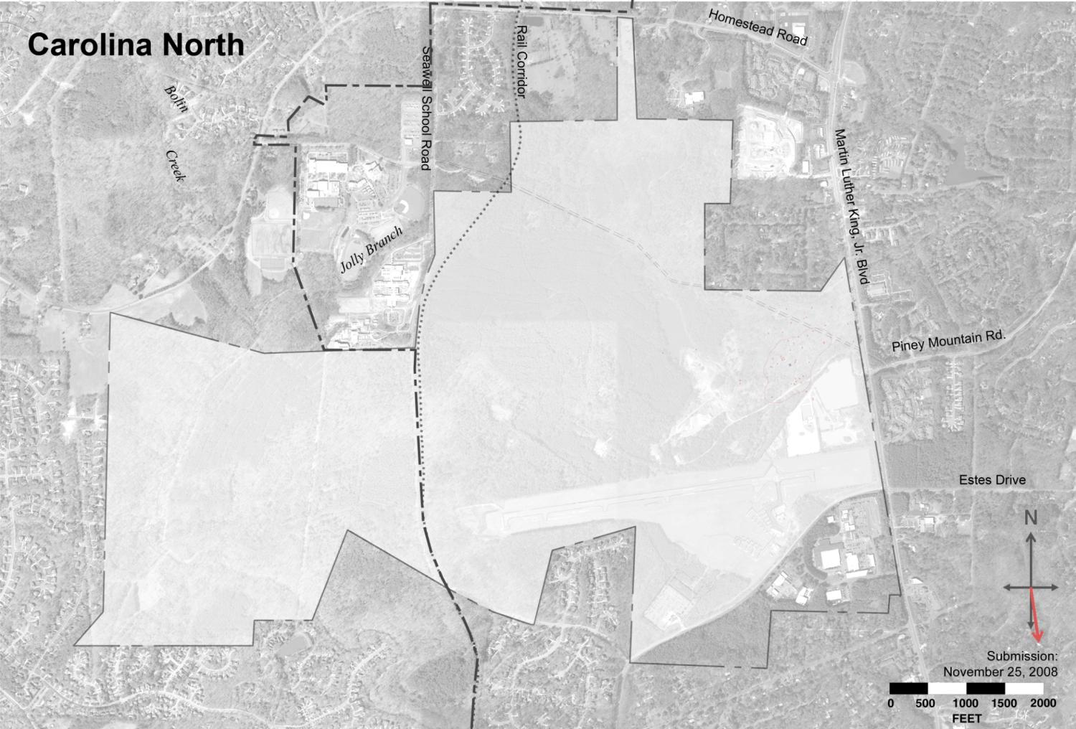
304 acres
Chapel Hill Carrboro
643 acres
Property Boundary (946.63 acres)
Municipal Boundary

Slide 3
Carolina North
What is Carolina North?
947 acres of land owned by the University
What will it be?
Mixed-use academic campus
Extension of the main campus
What does it mean to the University?
Provide space for necessary growth
Enable new activities and relationships
Enhance research mission

Slide 4
Carolina North – Milestones
University plans of 1995, 2000, 2004, 2007
Horace Williams Citizens Committee (2004)
Leadership Advisory Committee (January 2007)
Ecological Assessment (2007)
Trustee Design Guidelines (November 2008)
Fiscal Impact Analysis (March 2009)
Long Range Transit Study (April 2009)
Traffic Impact Analysis (May 2009)
Town-University Collaboration (2008-09)
Development Agreement (June 2009)
First Annual Report (September 2010)

Slide 5
Negotiations:
Town Council
and
UNC-CH Board of Trustees
2008-09
Create new U-1 Zone
Rezone 643 acres of Carolina North property to U-1
Adopt Development Agreement to manage development of Carolina North
Completed June 2009
Rezoned to U-1
643 acres
Property Boundary
Municipal Boundary

Slide 6
Development Agreement
Agreement between University and Town of Chapel Hill: a contract that defines certain
Rights
Obligations
Authorizes development of up to 3 million ft² over 20 years on a defined 133 acres of the Carolina North property
University to submit an Annual Report each year
For each party

Slide 7
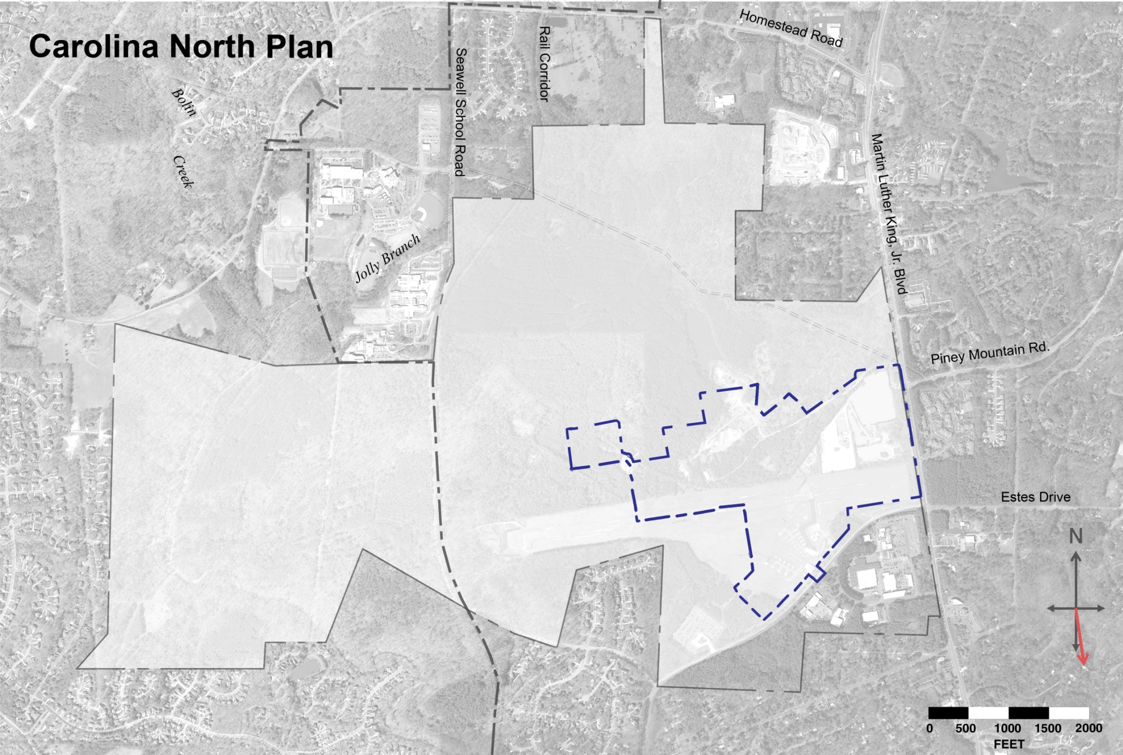
Development Agreement: 3 million sf of Development
on 133 acres over 20 years

Slide 8
Site Plan: first 3 million sf of Development

Slide 9
Carolina North Development Program for First 3 Million sf of Development
Land Use | Estimated GSF
Academic/University Support | 1,280,000
Private | 700,000
Civic/Retail | 70,000
Health Care | 200,000
Housing (750 units @ 1,000 sf avg) | 750,000
Recreation Fields (3) | N/A
Total | 3,000,000

Slide 10
Activities during 2009-10
Managing Carolina North responsibilities
Steering Committee within the University
Joint Staff Work Group – coordination with Town
Development Agreement
List of required Plans, Approvals, and Reports
Items to be addressed in each Annual Report
Traffic Impact Analysis (TIA)
Completed required update (Dec 2009)

Slide 11
Activities during 2009-10 (Cont.)
Completed geo-referenced plan
Two Minor Modifications approved
Realignments in development area
Alternative ped/bike solution along Seawell School Road
Campus-to-Campus Connector (C2C)
Town and University collaborated on workshops
Identified preferred route
C2C Report included in Annual Report

Slide 12
Activities during 2009-10 (Cont.)
Agreement for Chapel Hill Police Department to use former transportation administration building and associated parking
No development occurred at Carolina North during 2009-10

Slide 14
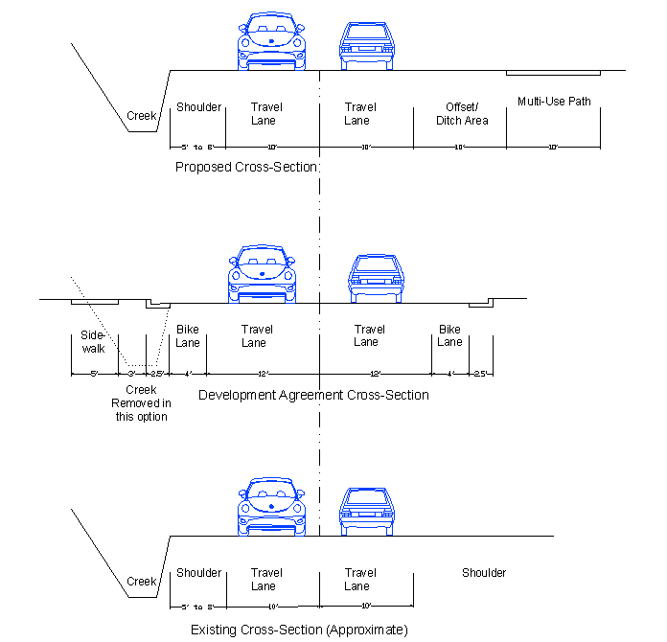
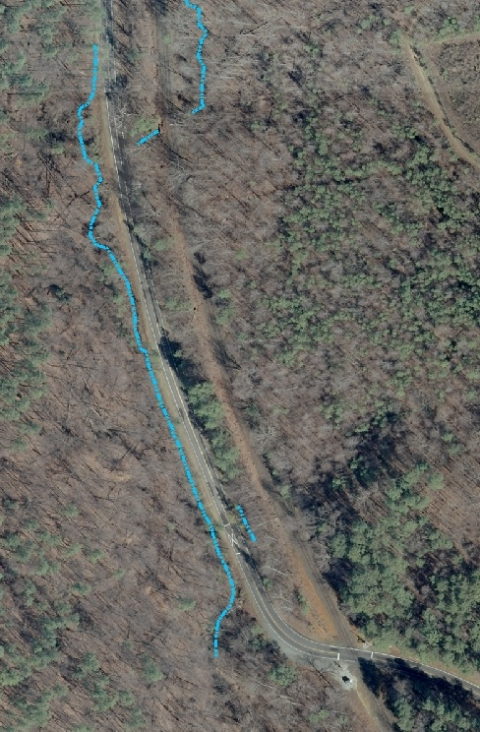
Development Agreement Minor Modification 2010 - 2
North
Seawell School Road
Existing
Stream
Approximate
location of
proposed
multi-use path
RR Crossing
Notes:
This is an example of the University’s efforts to avoid and minimize impacts to a stream along Seawell School Road. Separate bike and pedestrian facilities are a requirement of the Development Agreement with the Town of Chapel Hill. The University proposes to reduce impacts by combining the bike and pedestrian paths to a single multi‐use path on the east side of Seawell Road, away from the existing stream on the west side of the road, thus avoiding impact on approximately 600 linear feet of the creek. This reduction requires a minor modification to the Development Agreement. This proposed minor modification of the Development Agreement has been submitted to the Town of Chapel Hill.

Slide 15
Current Activities
Hangar Addition at RDU under construction
Purpose: Base of operations for MedAir
Completion expected by June 2011
Army Corps of Engineers Permit Application
Impact on streams, wetlands, and buffers
Mitigation strategy
Public information to be scheduled in late October
Planning for Research Building
Program (Occupants and activities)
Infrastructure
Conservation Easements
Future work

Slide 16
Current Status of Projects
Innovation Center – unlikely to happen (due to change in economy)
Law School – funding depends on Legislature
Research Building – could be first project
Infrastructure - planning

Slide 17
Links for Annual Report
Town of Chapel Hill link:
Navigate from: http://www.ci.chapel-hill.nc.us/
Or go directly to:
http://www.ci.chapel-hill.nc.us/Modules/ShowDocument.aspx?documentid=7540
University of North Carolina at Chapel Hill link:
Navigate from: http://www.unc.edu/index.htm
Or go directly to:
http://research.unc.edu/ccm/groups/public/@research/@cn/documents/content/ccm3_021256.pdf

Slide 18
Ecological Assessment
Areas for development over 50 years
Limited development area
Areas for preservation

